Slide 1
Logic Families

Slide 2
Basic Characteristics of Logic Families
The main characteristics of Logic families include:
  Speed
  Fan-in
  Fan-out
  Noise Immunity
  Power Dissipation

Slide 3
Contt..
Speed: Speed of a logic circuit is determined by the time between the application of input and change in the output of the circuit.
Fan-in: It determines the number of inputs the logic gate can handle.
Fan-out: Determines the number of circuits that a gate can drive.
Noise Immunity: Maximum noise that a circuit can withstand without affecting theoutput.
HI state noise margin:
VNH = VOH(min) – VIH(min)
LO state noise margin:
VNL = VIL(max) – VOL(max)
Power: When a circuit switches from one state to the other, power dissipates.

Slide 4
Types
TTL– transistor-transistor logic based on bipolar transistors.
CMOS – complementary metal-oxide semiconductor logic based on
metal-oxide-semiconductor field effect
transistors (MOSFETs).
ECL – emitter coupled logic based on bipolar transistors.

Slide 5
Quiz poll
What is full form of CMOS.
Compact metal oxide semiconductor.
Complementary metal oxide semiconductor.
Complementary MOSFET.
Compact MOSFET.

Slide 6
Quiz poll
TTL is called transistor–transistor logic because both the logic
gating function and the amplifying function are performed by
Resistors
Transistors
Bipolar junction transistors
Resistors and transistors respectively

Slide 7
General Characteristics of Basic Logic Families
CMOS consumes very little power, has excellent noise immunity, and is used with a wide range of voltages.
TTL can drive more current and uses more power than CMOS.
ECLis fast, with poor noise immunity and high power consumption.

Slide 8
Quiz poll
TTL used power as compare to CMOS.
More
Less
Moderate

Slide 9
Complementary metal oxide semiconductor (CMOS)
most widely used family for large-scaledevices
combines high speed with low powerconsumption
usual y operates from a single supply of 5 – 15V
excellent noise immunity of about 30% of supply voltage
can be connected to a large number of gates (about 50)
many forms – some with t down to 1ns
PD
– power consumption depends on speed (perhaps 1 mW

Slide 10
Transistor-transistor logic (TTL)
based on bipolar transistors
one of the most widely used families for small- and medium-scale devices – rarely used for VLSI
typically operated from 5Vsupply
typical noise immunity about 1 – 1.6V
many forms, some optimised for speed,power, etc.
high speed versions comparable to CMOS(~ 1.5 ns)
low-power versions down to about 1mW/gate

Slide 11
Emitter-coupled logic (ECL)
based on bipolar transistors, but removes problems of storage time by preventingthe transistors from saturating
very fast operation - propagation delays of 1ns or less
high power consumption, perhaps 60 mW/gate
low noise immunity of about0.2-0.25 V
used in some high speed specialist applications, but now largely replaced by high speedCMOS

Slide 12
Quiz poll
Which logic is the fastest of all the logic families?
TTL
ECL
HTL
DTL

Slide 13
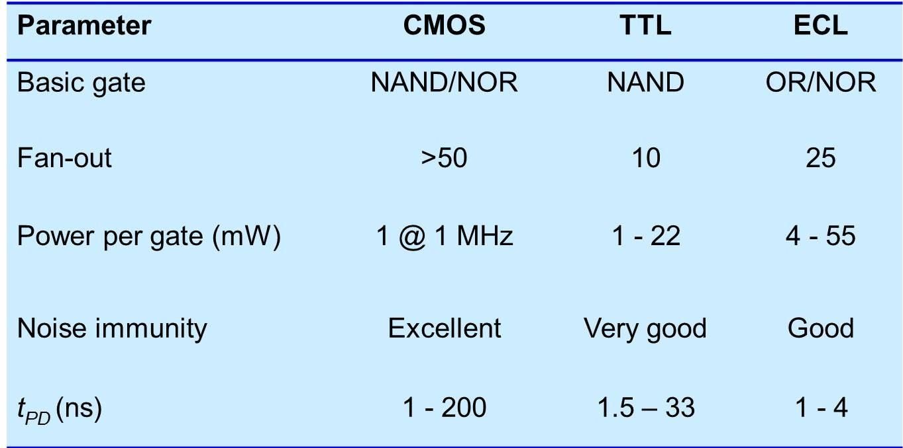
A Comparison of Logic Families

Slide 14
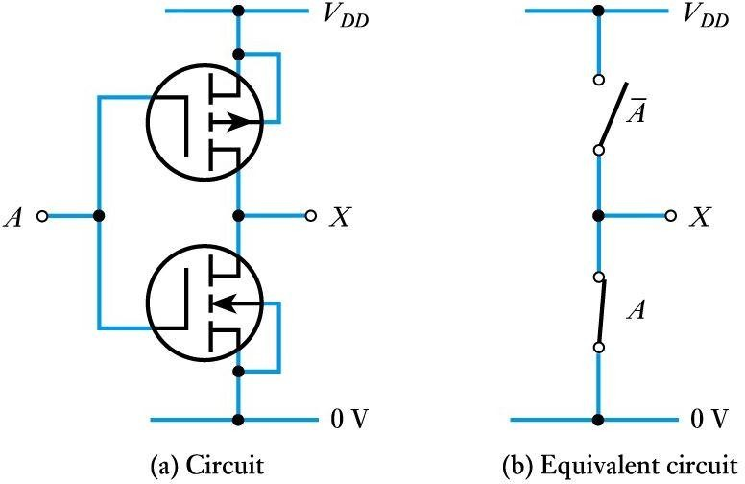
A CMOS inverter
PMOS
NMOS
Nmos if 0 it is off Nmos if 1 it is On Pmos if 0 it is on Pmos if 1 it is Off

Slide 15
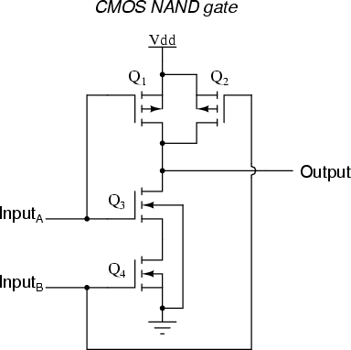
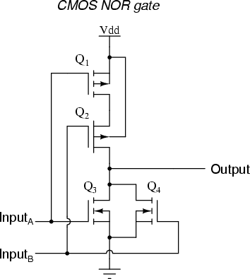
CMOS gates
Nmos if 0 it is off Nmos if 1 it is On Pmos if 0 it is on Pmos if 1 it is Off
If Pmos in parallel then Nmos in series and vice versa.
pmos
pmos
nmos
nmos

Slide 16
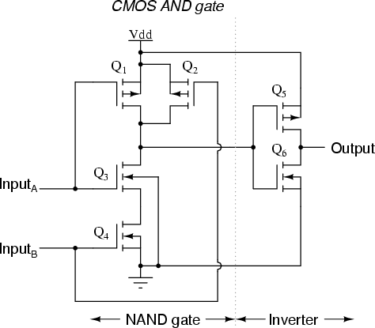
A CMOS AND Gate

Slide 17
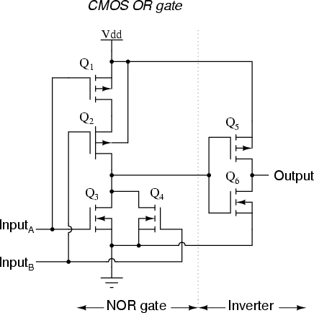
A CMOS OR Gate

Slide 18
Noise immunity
noise is present in all real systems
this adds random fluctuations to voltages representing logic levels
to cope with noise, the voltage ranges defining the logic levels are more tightly constrained at the output ofa gate than at the input
thus smal amounts of noise will not affect the circuit
the maximum noise voltage that can be tolerated by acircuit is termed its noise immunity, V_{NI}

Slide 19
Key Points
Physical gates are not ideal components
Logic gates are manufactured in a range of logic families
The ability of a gate to ignore noise is its ‘noise immunity’
Both MOSFETsand bipolar transistors are used ingates
All logic gates exhibit a propagation delay when responding to changes in their inputs
The most widely used logic families are CMOSand TTL
CMOS is available in a range of forms offering high speed or very low powerconsumption
TTL logic is also produced in many versions, each optimised for a particular characteristic

Slide 20
Key points about TTL
The most popular and most widely used IC family is TTL.
A TTL circuit acts as a current sink in the low state.
A TTL circuit acts as a current source in the high state
The TTL series most suitable at high frequencies is FTTL.
The fastest saturated logic family is TTL
The logic family most suitable for SSI and MSI is TTL

Slide 21
Key points about ECL
The fastest logic family is ECL
The logic family which gives complementary outputs is ECL
The logic family preferred in superfast computers is ECL
The logic family with both logic levelsnegative is ECL
The logic family which consumes maximum power is ECL

Slide 22
Key points about MOS
The logic family which is simplest to fabricate is MOS
The logic family ideally suited for LSI/VLSI/ULSI applications is MOS
The slowest logic family is MOS

Slide 23
Key points about CMOS
The ICsused in watches and calculators are of CMOS
The logic family which has the highest fan-out is CMOS.
The logic family which has highest noise margin is CMOS.
The logic family which consumes least power is CMOS.

